Slide 1

MUSIC STORE DATA ANALYSIS

Slide 2

PRESENTING THE
GLIMPSE OF THE PROJECT…..
PROBLEM STATEMENTS
& SOLUTIONS
PROJECT FOR FINDING SOME USEFUL INSIGHTS FOR
BUSINESS GROWTH OF MUSIC STORE USING SQL

Slide 3
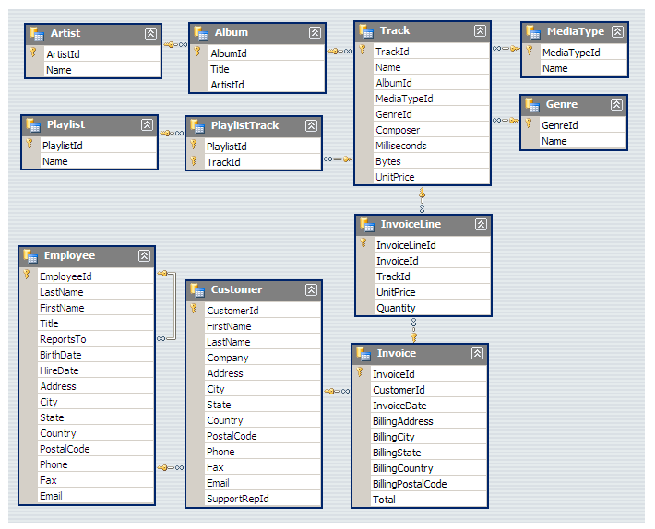
Understanding the dataset :
The Music store dataset contains total 11 tables.
The schema diagram for this dataset is shown below.

Slide 4
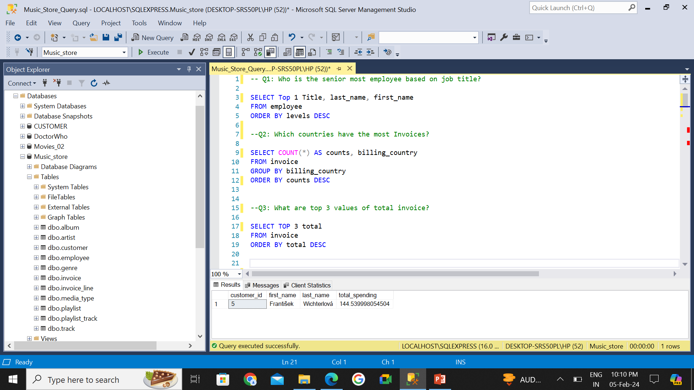
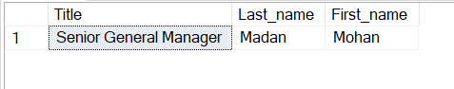
Who is the senior most employee based on job title?
Query 1

Slide 5
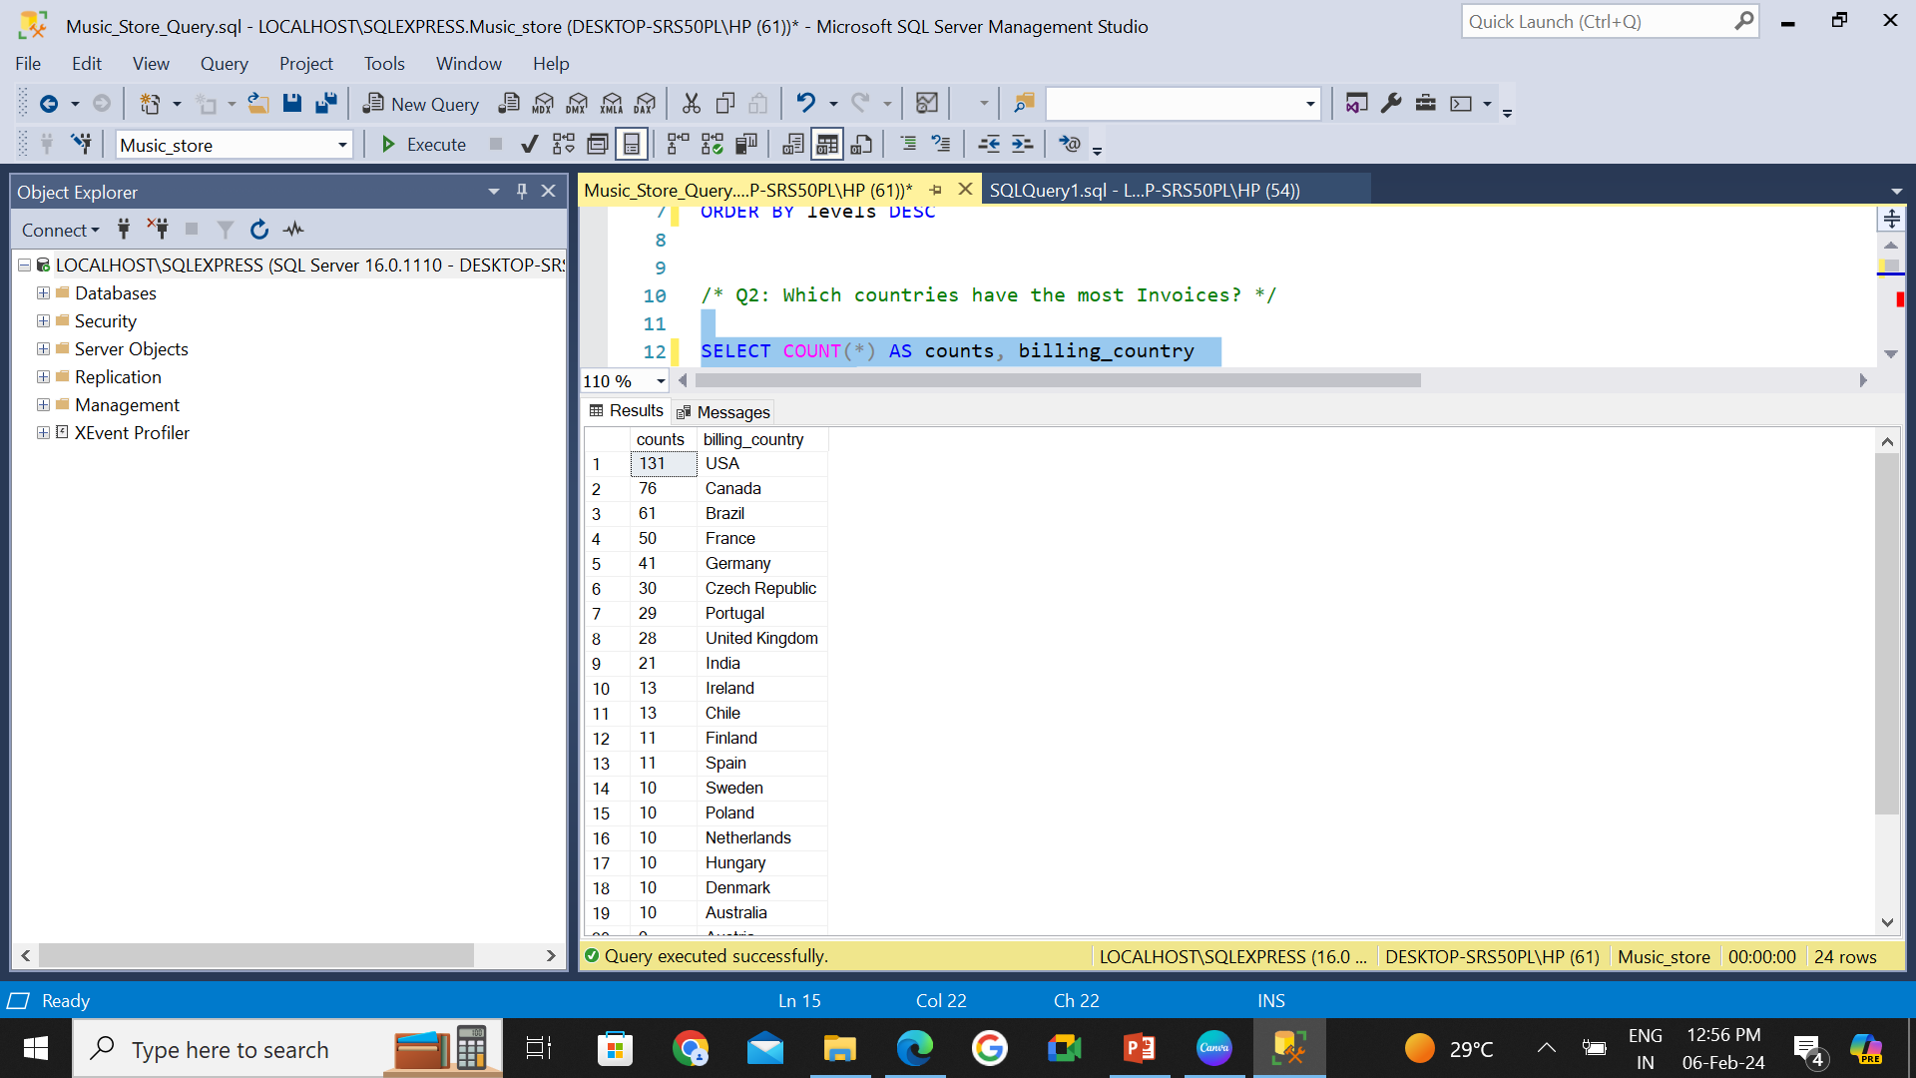
Which countries have the most Invoices?
Query 2

Slide 6
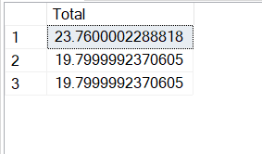
What are top 3 values of total invoice ?
Query 3

Slide 7
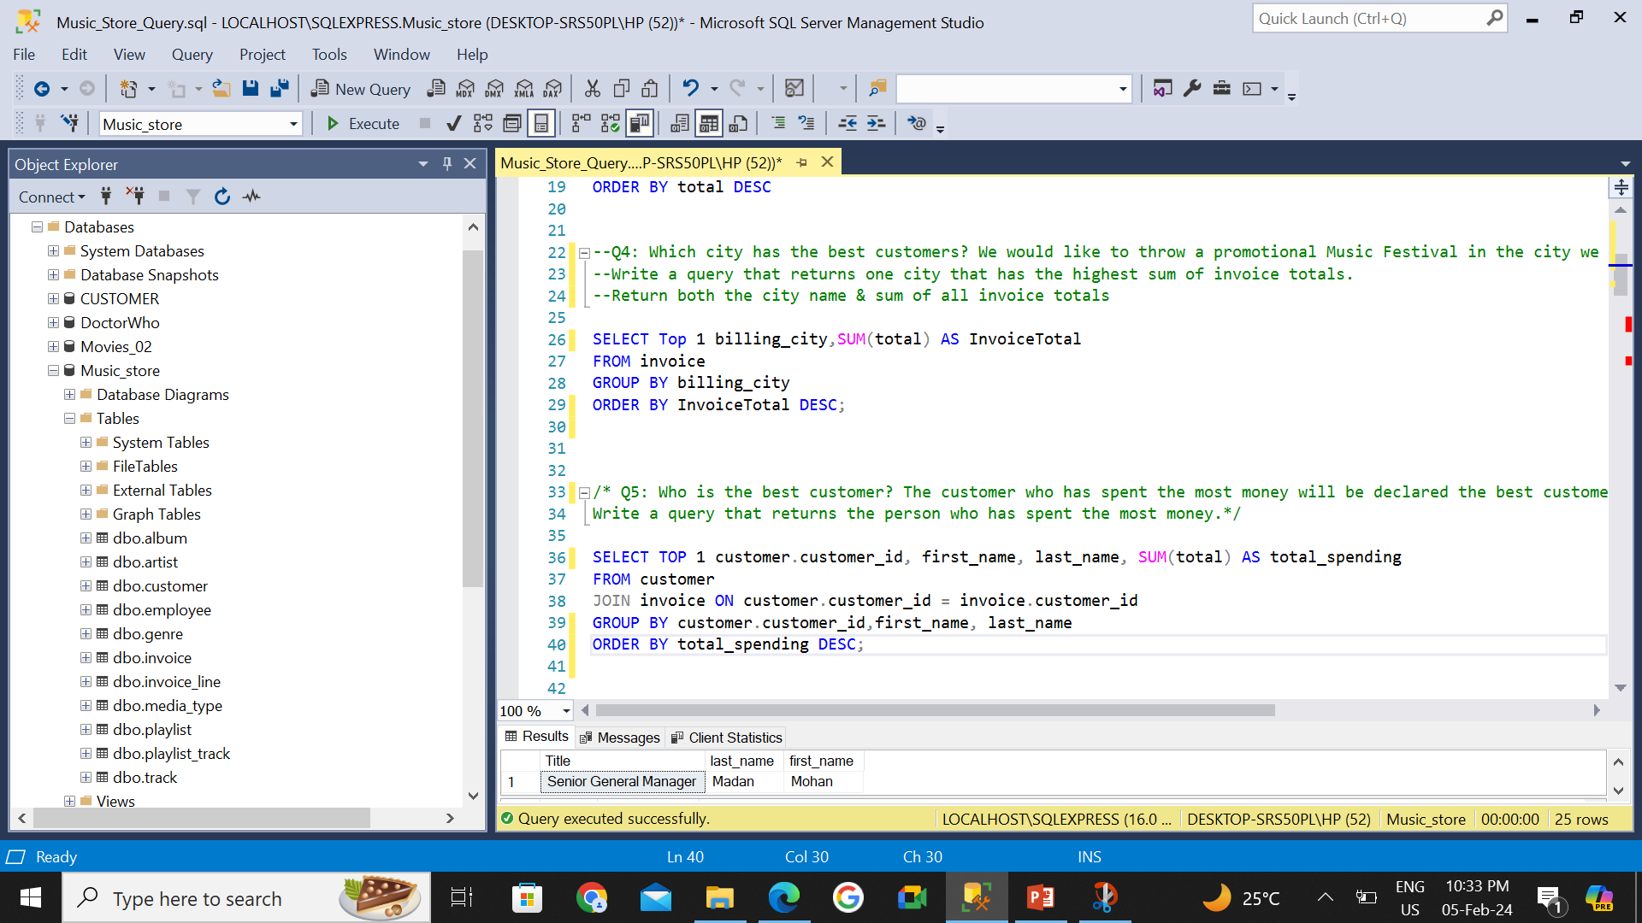
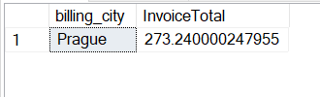
Which city has the best customers? We would like to throw a promotional Music Festival in the city we made the most money. Write a query that returns one city that has the highest sum of invoice totals. Return both the city name & sum of all invoice totals
Query 4

Slide 8
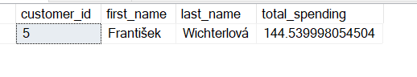
Who is the best customer? The customer who has spent the most money will be declared the best customer. Write a query that returns the person who has spent the most money
Query 5

Slide 9
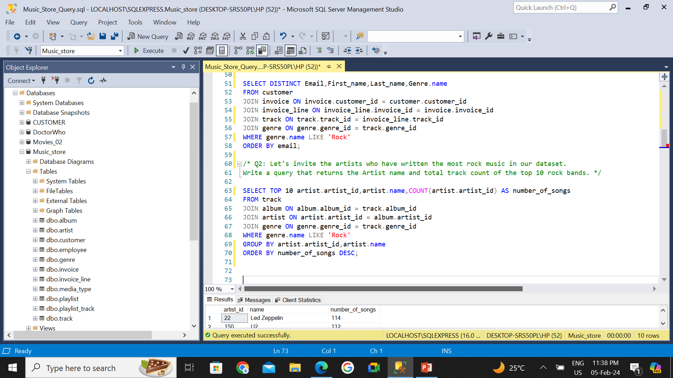
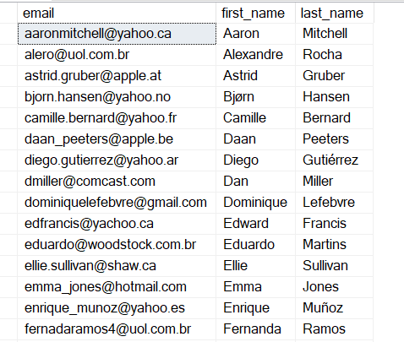
Write query to return the email, first name, last name, & Genre of all Rock Music listeners. Return your list ordered alphabetically by email starting with A
Query 6

Slide 10
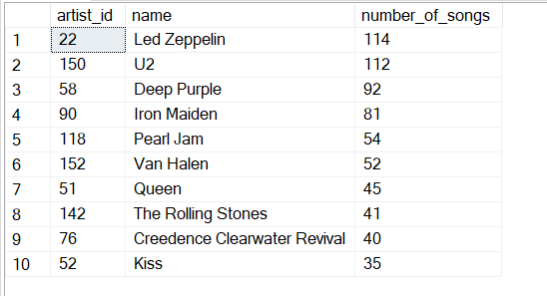
Let's invite the artists who have written the most rock music in our dataset. Write a query that returns the Artist name and total track count of the top 10 rock bands
Query 7

Slide 11
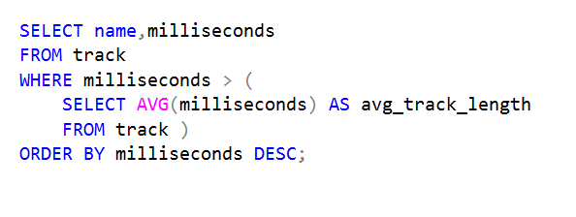
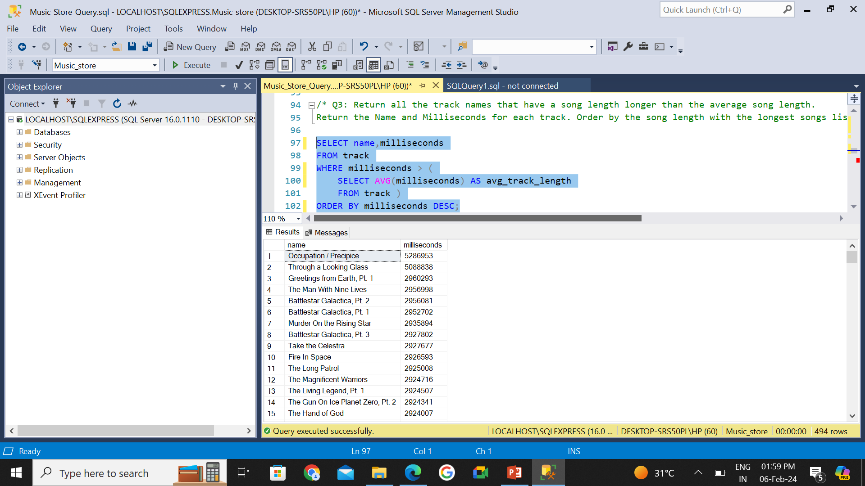
Return all the track names that have a song length longer than the average song length. Return the Name and Milliseconds for each track. Order by the song length with the longest songs listed first
Query 8

Slide 12


